Slide 1
Computer

Slide 2
Input devices
Input devices for interactive use, allowing text entry, drawing and selection from the screen:
text entry: traditional keyboard, phone text entry, speech and handwriting
pointing: principally the mouse, but also touchpad, stylus and others
3D interaction devices.

Slide 3
Output devices
Output display devices for interactive use:
different types of screen mostly using some form of bitmap display
large displays and situated displays for shared and public use
digital paper may be usable in the near future
Virtual reality systems and 3D visualization which have special interaction and display devices.

Slide 4
Text entry devices
The alphanumeric keyboard
Chord keyboards
Phone pad and T9 entry
Handwriting recognition
Speech recognition

Slide 5
The alphanumeric keyboard
The vast majority of keyboards have a standardized layout, known by the first six letters on the top row: QWERTY.
The non-alphanumeric keys are not standardized.
This layout is not optimal for typing, but dates from the time of mechanical limitations of the typewriter.
Today, the keys can also be arranged in alphabetic order (the alphabetic keyboard), but this does not improve typing performance.

Slide 6
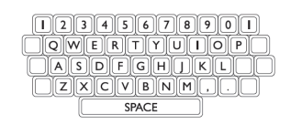
QWERTY Keyboard

Slide 7
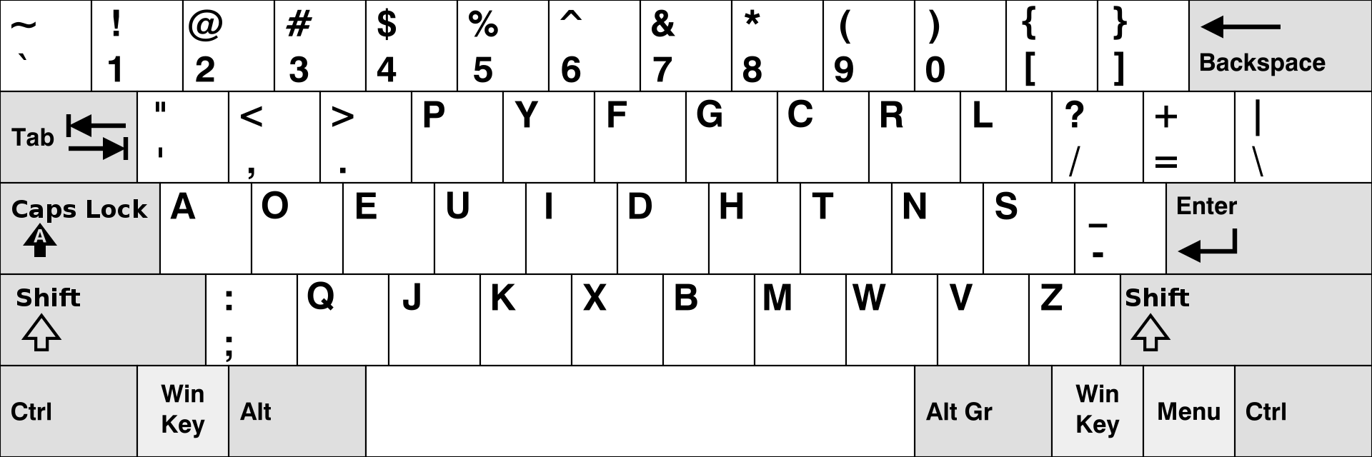
DVORAK keyboard
The DVORAK keyboard does, placing the keys in a different order on a similar layout as found on the QWERTY keyboards.
The layout minimized the stretch of fingers and the use of weak fingers, reducing fatigue and increasing typing speed (10-15%).

Slide 8
Chord keyboards
Is a computer input device that allows the user to enter characters or commands formed by pressing several keys together, like playing a "chord" on a piano.
The large number of combinations available from a small number of keys allows text or commands to be entered with one hand, leaving the other hand free. On chord keyboards, only a few keys are used.
Letters are produces pressing multiple keys at once. They are smaller than conventional keyboards and have a short learning time.

Slide 9
Phone pad and T9 entry
The numeric keys on a cellphone can be pressed more than once to enter letters. Most phones have 2 keypad modes: a numeric and an alphabetic mode.
Most phones have additional modes for entering (initial) capitals. On modern phones you can also find the T9-algorithm (The acronym T9 stands for Text on 9 keys.
T9 predictive texting makes SMS messaging faster especially for non-QWERTY cell phones without full keyboards.

Slide 10
Instead of tapping the “4” key three times to input the letter “i” in a text message, with T9 you can just tap “4663” to spell the word “good”.
With T9 active, you only have to tap each number once per letter. Most modern cell phones have T9 included and activated by default.
This uses a large dictionary to disambiguate words by typing the relevant letters keys once.

Slide 11
Handwriting recognition
Current technology is still fairly inaccurate and makes a lot of mistakes, partly due to the enormous differences between people‟s handwriting.
HR deals mostly worth stroke information: the way in which the letter is drawn, not the letter itself. Therefore, online recognition is most accurate.
HR has the advantage of size and accuracy over small keyboards and are therefore often used in mobile computing

Slide 12
Speech recognition
The performance of speech recognition is still relatively low, even for a restricted vocabulary.
Adjusting the system for use with natural language gives birth to even more problems: the errors in natural language use, different voices, emotions and accents etc.
This means the system has to be tuned for each different user.
SR can be used in 3 scenarios: as an alternative text entry device, replacing the keyboard in the current software, with new software especially designed for SR and in situations where the use of keyboards is impractical or impossible.

Slide 13
Positioning, pointing and drawing

Slide 14
The mouse
The mouse is an indirect input device, because a transformation is required to map from the horizontal nature of the desktop to the vertical alignment of the screen.
Invented in 1964 by Engelbart, his mouse used 2 wheels that slid across the desktop and transmitted x; y-coordinates to the computer.
There have been experiments with foot-controlled mice.

Slide 15
Touchpad
Touchpads are touch-sensitive tablets, operated by sliding the finger over it and are mostly used in notebook computers.
Performance can be increased using accelerators.

Slide 16
Trackball and thumbwheel
A trackball is an upside-down mouse: instead of moving the device itself, the ball is rolled to move the cursor. Trackballs are often used by RSI users.
Thumb-wheels (in 2 dimensions) offer less usability because they can only manipulate the horizontal and vertical movement of the cursor.
1-dimensional thumbwheels are often included on the normal mice to enhance the scrolling.

Slide 17
Joystick and keyboard nipple
There are two types of joysticks:
Absolute sticks, in which the position of the cursor corresponds to the position of the joystick in its base, and
Isometric sticks, in which the pressure on the stick (in a certain direction) controls the velocity of the cursor in that direction.
Keyboard nipples are tiny joysticks that are sometimes used on notebook computers

Slide 18
Touch-sensitive screens (touchscreens)
Touchscreens detect the position of the user’s finger or stylus on the screen itself and are therefore very direct.
They work by having the finger/stylus interrupting a matrix of light beams, making capacitance changes on a grid overlaying the screen or by ultrasonic reflections.
It is a direct device: no mapping is required

Slide 19
Stylus and lightpen
For more accurate positioning, systems with touch-sensitive surfaces often imply a stylus.
An older technology for the same purpose is the lightpen, which emits radiation detected by the screen.
A difficulty of this and other direct devices is that pointing obscures the display, making it more difficult to use in rapid successions.

Slide 20
Digitizing tablet
A device used for freehand drawing. A resistive tablet detects point contact between two separated conducting sheets.
Magnetic, capacitive and electrostatic tablets use special pens.
The sonic tablet requires no pad: an ultrasonic sound emitted by the pen is detected by 2 microphones.

Slide 21
Eyegaze
Eyegaze allows you to control the computer by looking at it, while wearing special glasses, head-mounted boxes etc.
By tracking a laser beam’s reflection in the eye, the direction in which the eye is looking is determined.
The system needs to be tuned and is very expensive, but also very accurate.

Slide 22
Display devices

Slide 23
Bitmap displays, resolution and color
A bitmap-base means that the display is made of a fixed number of dots or pixels in a rectangular grid.
The color or intensity at each pixel is held by the computer’s video card. The more bits per pixel, the more colors/intensities are possible.
Resolution of the screen: the total number of pixels (in a 4:3-ratio) and the density of the pixels.
Antialiasing
softening the edges of line segments, blurring the discontinuity and making the juggles less obvious.

Slide 24
Technologies
In a CRT-monitor a stream of electrons is emitted from an electron gun, which is than focused and directed by magnetic fields.
As the beam hits the phosphor-coated screen, the phosphor is excited by the electrons and glows. Flicker can be reduced by increasing the scanning rate or by interlacing, in which odd lines are scanned first, followed by even lines.
In LCD’s a thin layer of liquid crystals is sandwiched between two glass plates. External light passes through the top plate and is polarized.
This passes through the crystal and is reflected back to the user’s eye by the bottom plate. The polarization of each single crystal can be turned electronically.

Slide 25
Digital paper
Thin flexible material that can be written to electronically, but keeps it’s contents when removed from the power supply.

Slide 26
Devices for virtual reality and 3D interaction

Slide 27
Positioning in 3D
Changing from 2D to VR does not mean going to 3 degrees of freedom, but (sometimes) to 6, because except for moving in 3 dimensions, you can also roll, turn, twist etc.
Humans can use a 3D-environment with a 2D-device (mouse).
The human mind is therefore capable of handling multiple degrees of indirection. A 3D-input device is the 3D-mouse, which has 6 degrees of freedom: 3 for position (x,y,z), 1 for pitch, yawn and roll.

Slide 28
However, sometimes its better to use a data glove: a lycra glove with fibers laid around the fingers, detecting the joint angles of the fingers and thumb.
The position of the head can be tracked using a VR-helmed, which can also display the 3D-world to each eye.
With other devices, e.g. special clothing or a modified trampoline, the position and movement of the whole body can be tracked

Slide 29
3D displays
3D can be displayed on normal screens using shadows, depth etc.
It is also possible to generate the natural stereoscopic images for both eye positions and have them delivered to the eyes using a VR-helmed.
Finally, users can enter a VR cave, where the VR world is projected around them.
If the VR-system performances too slow, and there is a delay between movement and image, disorientation and sickness may occur

Slide 30
Physical controls, sensors and special devices
Special displays
Except for CRT and LCD, there are numerous other display devices, e.g. LED’s, ganges, dials and headup displays.
Sound output
We do not yet know how to utilize sound in a sensible way to achieve maximum effects and information transference in HCI. However, by having sounds confirm a right action, we can speed up interaction.
Touch
feel and smell Force feedback gives different amounts of resistance to an input device depending on the state of the virtual operation. Haptic devices are various forms of force, resistance and texture influencing our physical senses.

Slide 31
Physical controls, sensors and special devices
Physical controls
Not only the function of controls, but also the physical design is important and needs to suit the situation in which it is used: kitchen equipment, for example, needs controls that can be cleaned easily.
Environment and bio-sensing
There are many sensors in our environment monitoring our behavior. Their measurements range from temperature and movement to the user’s emotional state.

